Slide 1
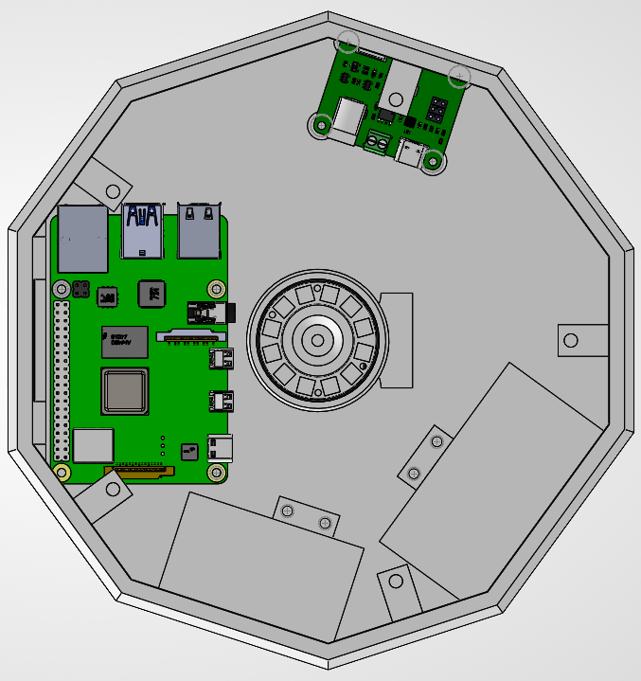
Top-Down View
Motor Control
Raspberry Pi
LED Ring
12V Supply
5V Supply

Slide 2
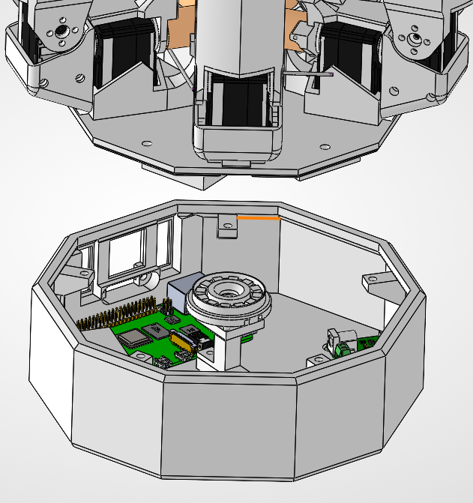
Expanded View
Moving Fingers
LED Ring
Raspberry Pi

